Slide 1


Abstra
Lazar Milicevic
Weekly support report
Support, Challenges, Sollutions
04.02.2024

Slide 2
Agenda
1. Zendesk ↔ AWS Integration Progress
3. Weekly Presentations
5. Next Steps
2. Zendesk Ticket Management
4. Challenges & Solutions

Slide 3
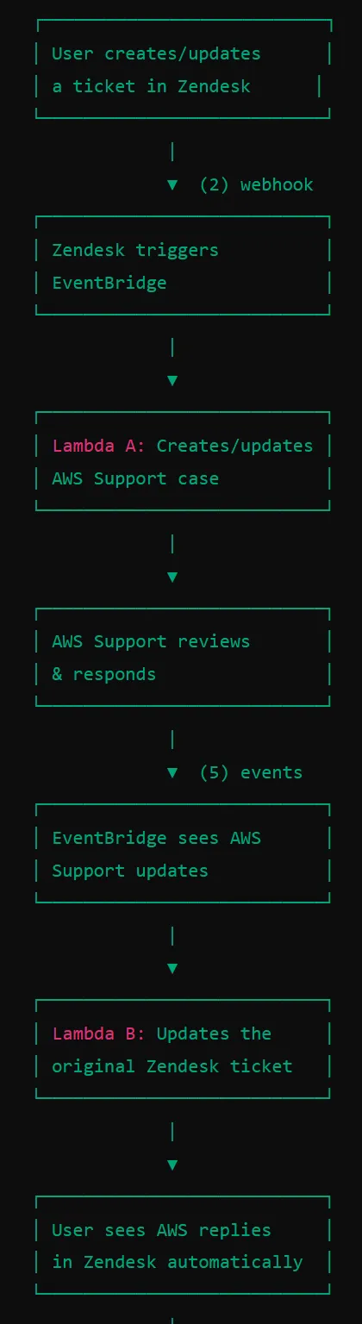
Zendesk ↔ AWS Integration Progress
Customer success: Weekly Support Report – 30.01.2025
What was done:
✅ AWS Support Cases
✅ Successfully closed all test support cases on AWS
.
Ensured no test cases remain open to maintain a clean support environment.
Verified that all cases were properly handled and resolved before closure.
✅ Completed full technical documentation for AWS-Zendesk integration.
Created a comprehensive Notion guide for future engineers to reference.
Document includes setup details, troubleshooting steps, and best practices.
Available on Notion: AWS-Zendesk Support Integration Guide

Slide 4
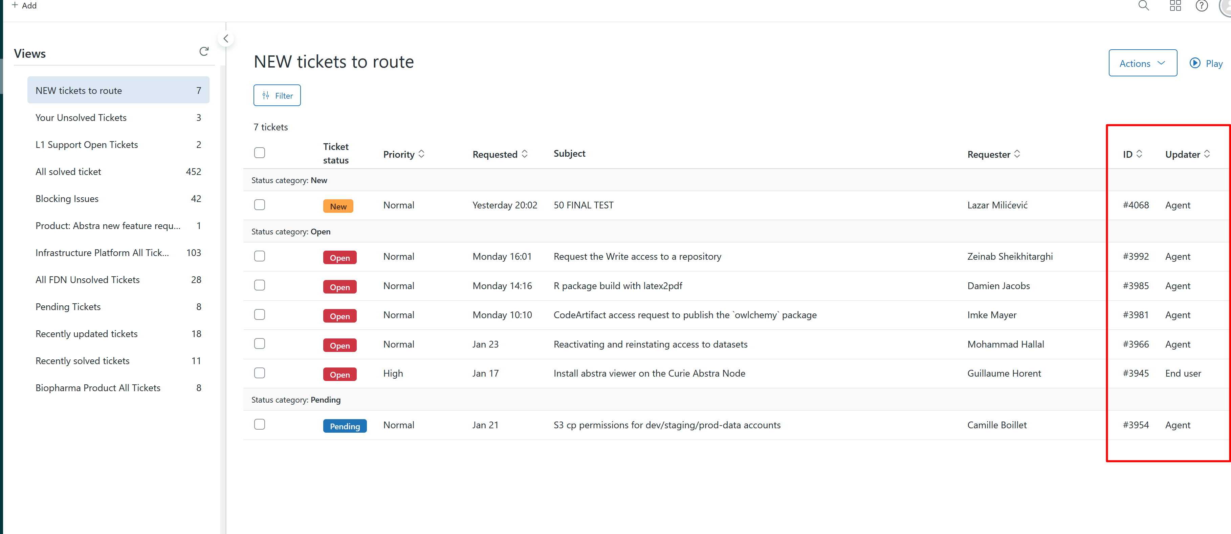
Zendesk Ticket Management
Customer success: Weekly Support Report – 30.01.2025
What was done:
✅ Regular daily activities, providing support via Zendesk and Slack dedicated channels
✅ Managed and routed Zendesk tickets efficiently.
Ensured timely responses and assigned tickets to the appropriate teams.
Worked on optimizing ticket routing for better problem resolution.

Slide 5
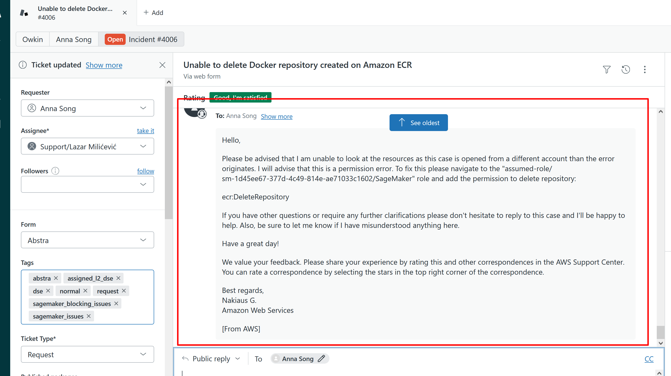
Challenges & Solutions
Customer success: Weekly Support Report – 30.01.2025
What was done:
Issue: First user submitted a ticket through the new SageMaker Issues Form, and AWS Support case was automatically created.
Owkin agents were confused by AWS engineers responding in the ticket.
✅ Solution:
Integration needs to move to production as soon as possible to avoid confusion.
A quick user guide should be shared to explain how to create tickets properly using the form.

Slide 6
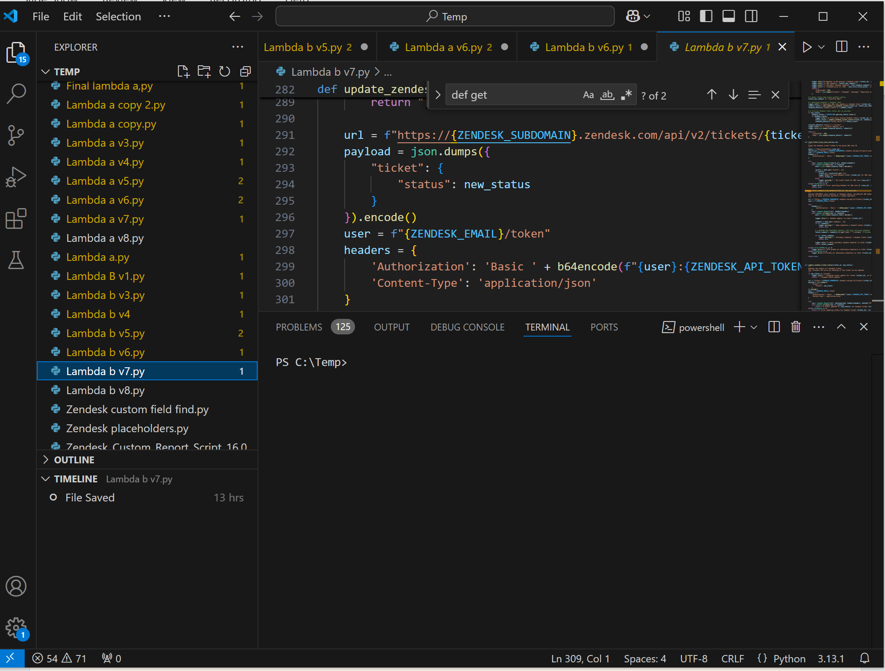
Next Steps
Customer success: Weekly Support Report – 30.01.2025
What will be done:
Deploy AWS-Zendesk integration to production and communicate the process clearly to users.
Monitor initial live usage and resolve any early issues.
Continue refining the Zendesk ticket handling process for better efficiency.
Keep improving documentation and support workflows for long-term stability.

Slide 7
Thank you!

